Slide 1
Sentiment Analysis on Movie Review
Using ML Approach
SMAI Project, Spring ‘21, IIIT Hyderabad
Team: BinaryBeasts Mohee, Rohith, and Sridhar
[2018112005, 2020201042, 2018111021]

Slide 2
TABLE OF CONTENTS
1.
4.
2.
5.
3.
6.
INTRODUCTION
RESULTS
What is this paper about?
What all results we got at various scenarios
SCOPE
INFERENCES
What to expect in this project?
Our observations and thoughts
EXPERIMENTATIONS
TEAM and WORK
Combinations we tinkered with
Who did what and how much?

Slide 3
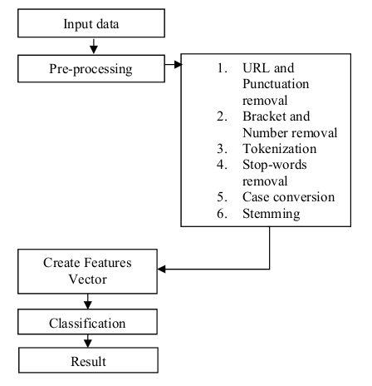
Introduction
Movies are one of the most popular form of entertainment for mankind and it is common for to people watch and express their opinions about it on the internet. Everyday huge amounts of data are generated of such opinions.
People often tend to check rating and reviews before watching the movie.
By analyzing movie review data we can learn about the strong and weak point of a movie and tell us if the movie meets the expectation of the user.
Sentiment analysis (SA) helps in analysing the review of that movie.
YOUR LOGO

Slide 4
Scope of the research paper
Increasing the scope of the project
The research paper aims to compare different machine learning classification techniques over a single feature extraction method
Feature extractor: TF-IDF
Classifiers: MNB, BNB, Maximum Entropy(LR), SVM, and Decision Tree
We have compared some DL and ML classification techniques to classify the movie reviews for a set of feature extraction methods
Feature extractor: TF-IDF, GloVE, Word2Vec, Doc2Vec, and Bag of words
Classifiers: MNB, BNB, ME(LR), SVM, Decision Tree, CNN, and LSTM

Slide 5
Scope of the Research Paper :-
Maximum Entropy
Support Vector Machine
DATASET
TF-IDF
Decision Tree
Bernoulli Naive Bayes
Multinomial Naive Bayes

Slide 6
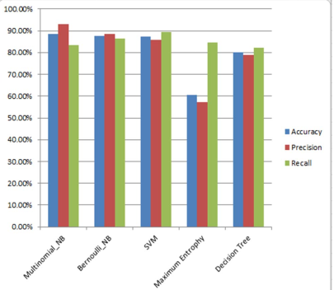
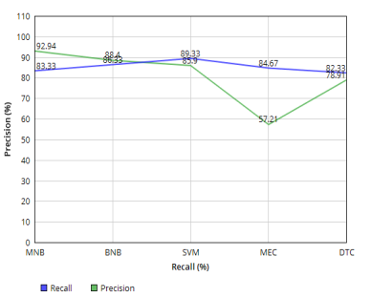
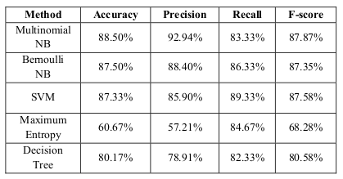
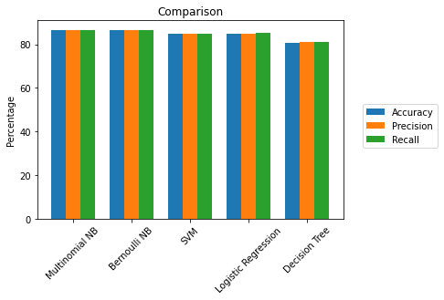
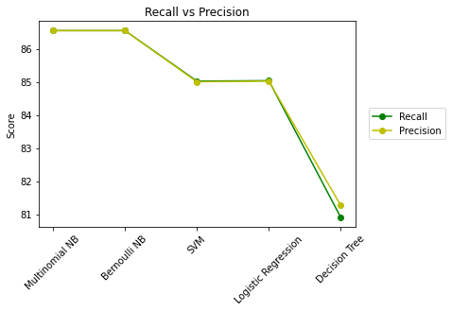
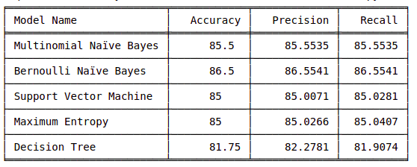
Paper’s Results
Our Results link to dataset

Slide 7
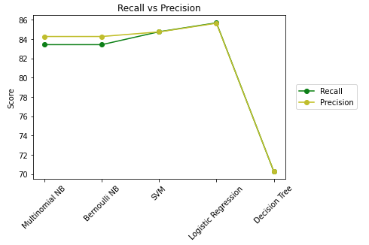
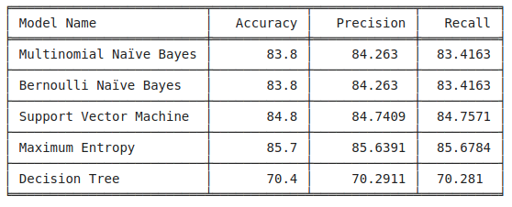
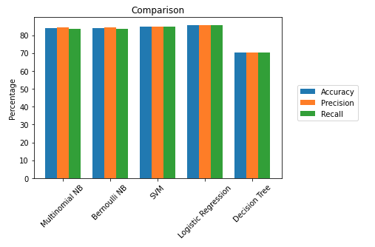
Results for another dataset link to dataset

Slide 8
[BONUS] Increasing the scope :-
Maximum Entropy
TF-IDF
Support Vector Machine
Word2Vec
Decision Tree
DATASET 1
GloVe
Bernoulli Naive Bayes
Bag of Words
Multinomial Naive Bayes
Doc2Vec
CNN
LSTM

Slide 9
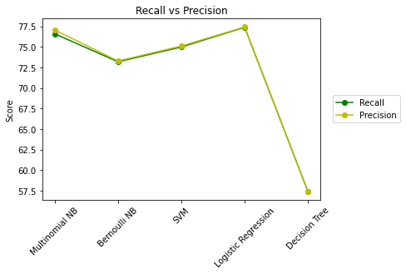
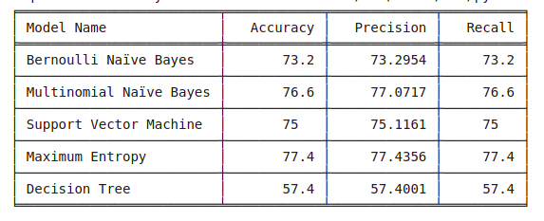
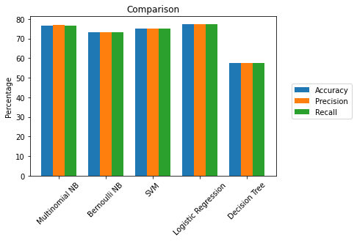
Doc2Vec

Slide 10
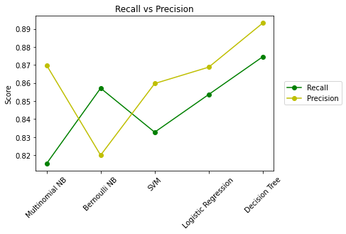
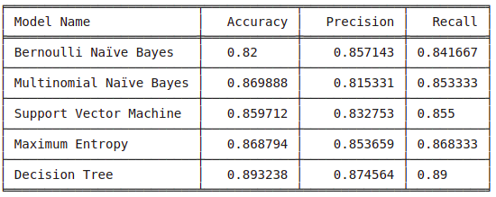
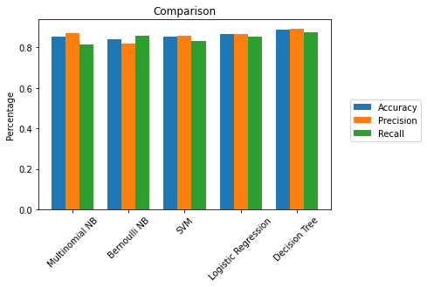
Bag of words

Slide 11
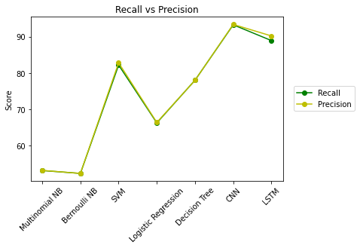
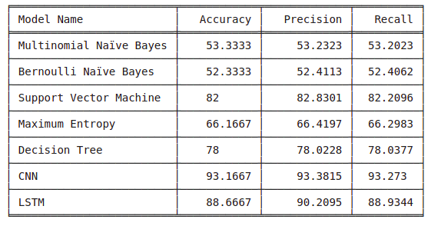
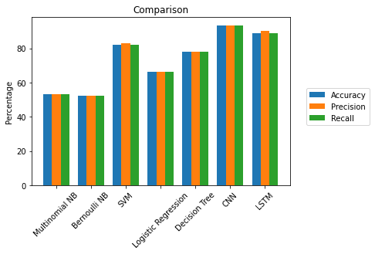
Word2Vec

Slide 12
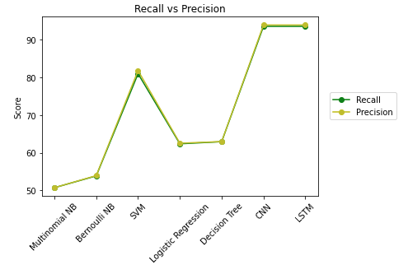
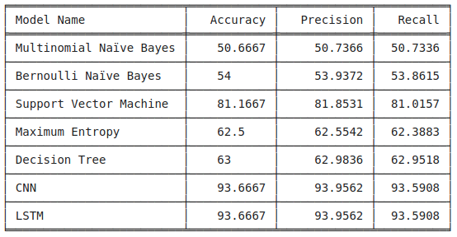
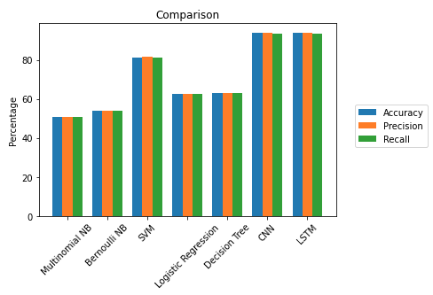
GloVe

Slide 13
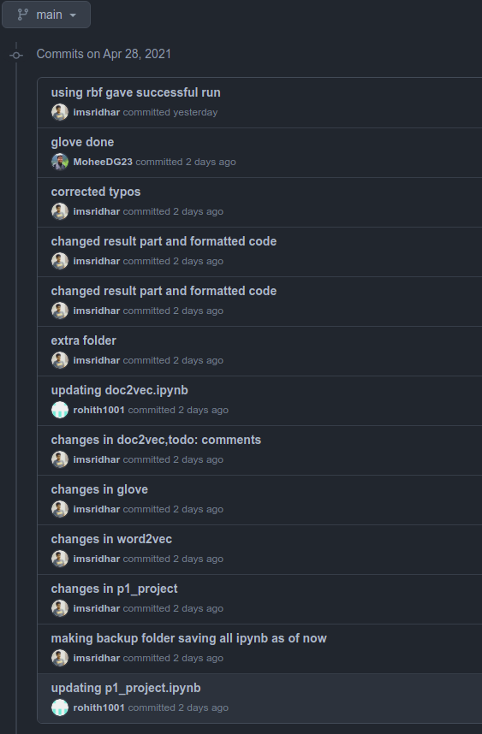
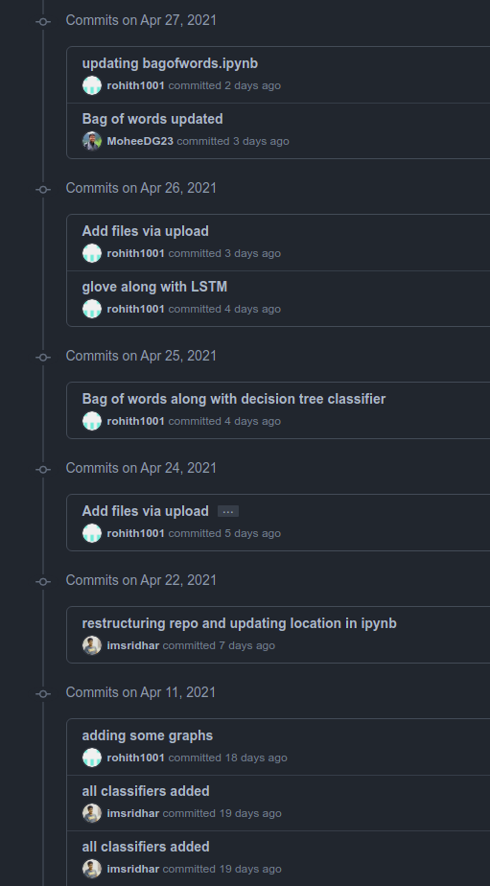
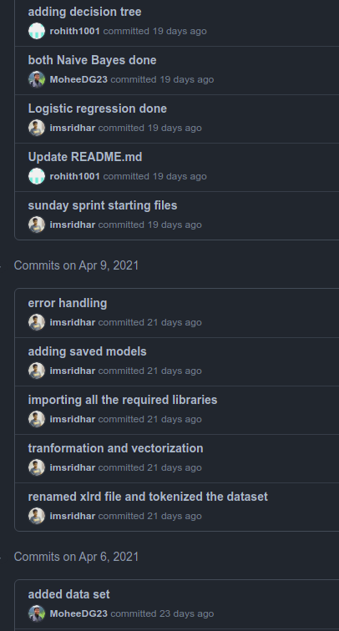
TEAM and WORK
link to our GitHub repo
Name | Contribution
Mohee | TF-IDF, Word2Vec,BoW, Data Preprocessing ,Slides and Documentation
Rohith | Glove, TF-IDF, Word2Vec,CNN,LSTM
Sridhar | CNN, LSTM , Classifiers, Slides and Documentation

Slide 14
References
Reference Papers
A. Rahman and M. S. Hossen, "Sentiment Analysis on Movie Review Data Using Machine Learning Approach," 2019 International Conference on Bangla Speech and Language Processing (ICBSLP), 2019, pp. 1-4, doi: 10.1109/ICBSLP47725.2019.201470.
Yessenov, Kuat, and Saša Misailovic. "Sentiment analysis of movie review comments." Methodology 17 (2009): 1-7.
T. P. Sahu and S. Ahuja, "Sentiment analysis of movie reviews: A study on feature selection & classification algorithms," 2016 International Conference on Microelectronics, Computing and Communications (MicroCom), 2016, pp. 1-6, doi: 10.1109/MicroCom.2016.7522583.
Blogs Referred
https://towardsdatascience.com/multiclass-classification-with-word-bags-and-word-sequences-4fffd4d62e0c
https://www.kaggle.com/dormann/cnn-vs-lstm-movie-review-classification
https://monkeylearn.com/sentiment-analysis/
https://github.com/linanqiu/word2vec-sentiments/blob/master/word2vec-sentiment.ipynb
https://medium.com/swlh/sentiment-classification-using-word-embeddings-word2vec-aedf28fbb8ca

Slide 15
THANK YOU!
Contact us at-
mohee.datta@research.iiit.ac.in
rohith.ramesh@students.iiit.ac.in
sridhar.m@research.iiit.ac.in

